Slide 1
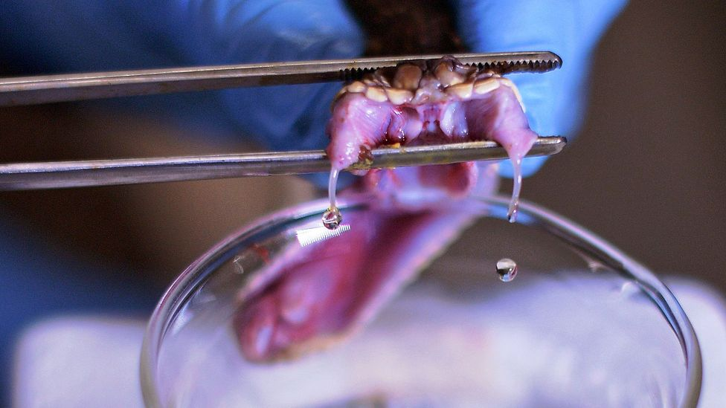
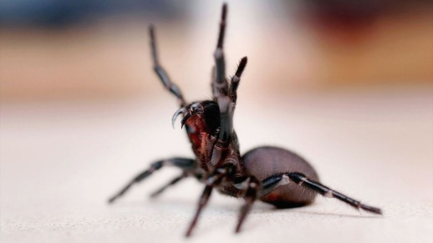

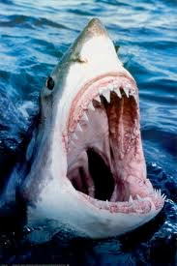

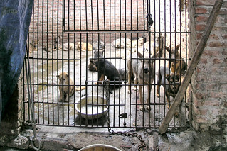
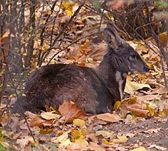
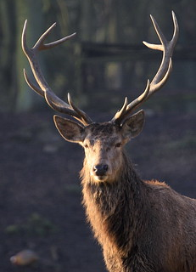
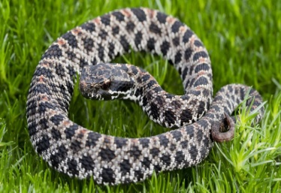
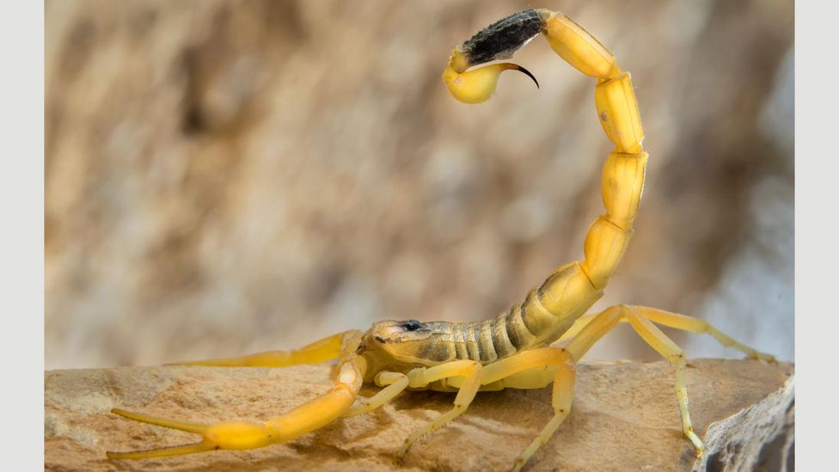
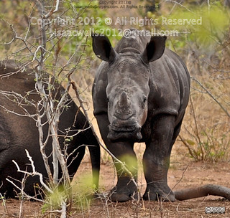
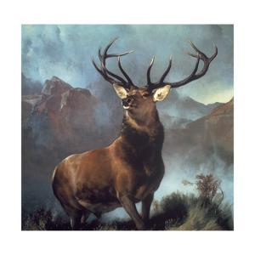
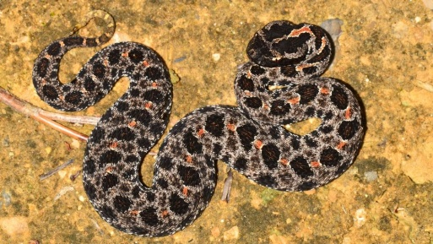
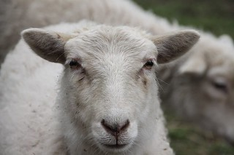
DRUGS OF ANIMAL ORIGIN
The bite of a funnel-web spider can kill a human, but one component of its venom could prevent brain damage in stroke survivors
An expert extracts venom from a rattlesnake in Sao Paulo, Brazil (Credit: Getty Images)
The venom of a death-stalker scorpion helps researchers find, and remove, cancer tumors too small for even MRI scans to spot
The venom from a species of pygmy rattlesnake inspired Eptifibatide, a synthetic which prevents heart attacks

Slide 2
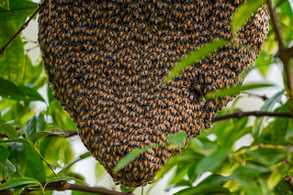
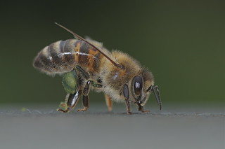
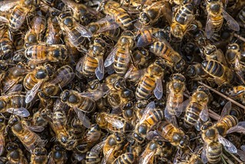
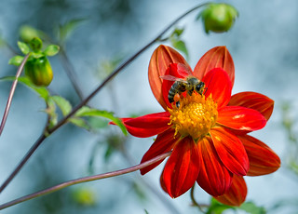
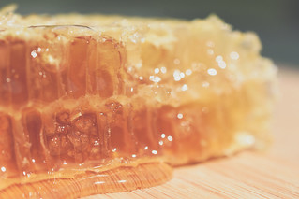
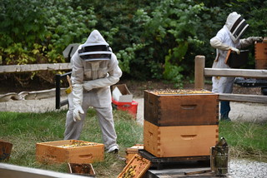
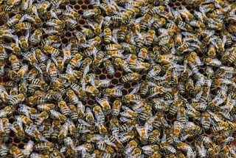
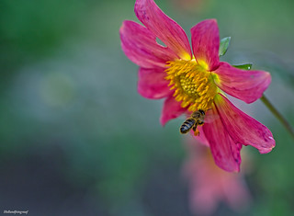
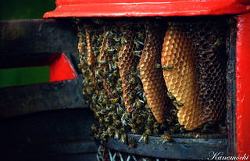
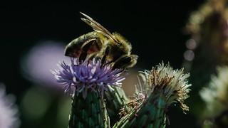
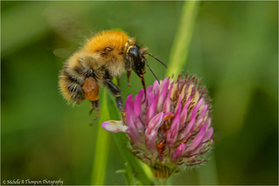
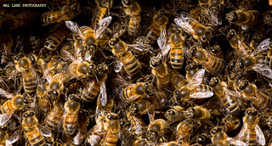
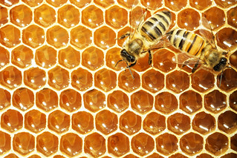
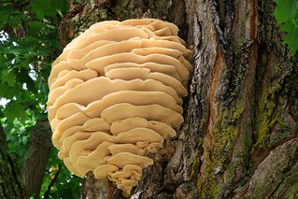
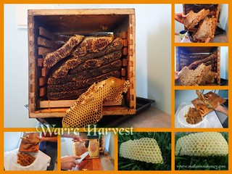

Slide 3
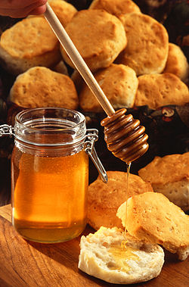
Honey
Honey is a sweet, viscous food substance made by Bees and some related insects.
Bees produce honey from the sugary secretions of plants (floral nectar) or from secretions of other insects (such as honeydew), by regurgitation, enzymatic activity, and water evaporation.
Bees store honey in wax structures called honeycombs.
The variety of honey produced by honey bees (the genus Apis millifera) is the best-known, due to its worldwide commercial production and human consumption.
Honey is collected from wild bee colonies, or from hives of domesticated bees, a practice known as beekeeping or “Apiculture”.

Slide 4
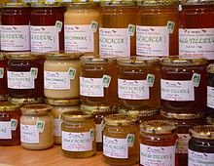
Traditional uses
The spiritual and therapeutic use of honey in ancient India is documented in both the Vedas and the Ayurveda texts, which were both composed at least 4,000 years ago.
In ancient Egypt honey was used to sweeten cakes, biscuits, and other foods.
In the absence of sugar, honey was an integral sweetening ingredient in Greek and Roman cuisine.
During Roman times, honey was part of many recipes and it is mentioned in the work of many authors, including Virgil, Pliny, and Cicero.
Honey from different floral sources, with visible differences in color and texture

Slide 5
Medicinal uses
Wounds and burns
Honey is a popular folk treatment for burns and other skin injuries. Preliminary evidence suggests that it aids in the healing of partial thickness burns 4–5 days faster than other dressings, and moderate evidence suggests that post-operative infections treated with honey heal faster and with fewer adverse events than with antiseptic and gauze.
Antibacterial
Components of honey under preliminary research for potential antibacterial properties include methyl glyoxal, hydrogen peroxide, and royalisin (also called defensin-1).

Slide 6
Conti…
Cough
WHO recommends honey as a treatment for coughs and sore throats, including for children. Honey is recommended by one Canadian physician for children over the age of one for the treatment of coughs, as it is deemed as effective as dextromethorphan and more effective than diphenhydramine.

Slide 7
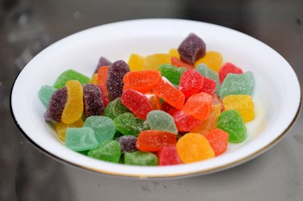
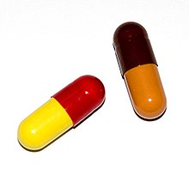
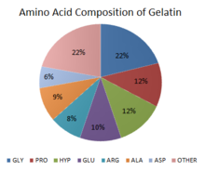
GELATIN
Gelatin or gelatin (from Latin: gelatus meaning "stiff" or "frozen") is a translucent, colorless, flavorless food ingredient, derived from collagen taken from animal body parts. Brittle when dry and gummy when moist, it is also called hydrolyzed collagen, collagen hydrolysate, gelatine hydrolysate, hydrolyzed gelatin, and collagen peptides.
It is commonly used as a gelling agent in food, medications, drug and vitamin capsules, papers, and cosmetics.
Capsules made of gelatin

Slide 8
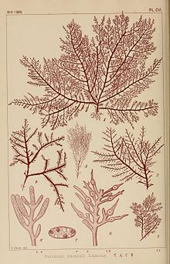
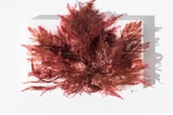
Medicinal uses
Gelatin is used for
Weight loss
Treating osteoarthritis, rheumatoid arthritis, and brittle bones (osteoporosis).
Some people also use it for strengthening bones, joints, and fingernails.
Gelatin is also used for improving hair quality and to shorten recovery after exercise and sports-related injury.
Gelidium
Gelatin is a natural product derived from animal skin, bones and tendons. The most common forms of gelatin are powder or granulated products. Gelatin is labeled typically animal-derived, although vegetarian gelatin is available. Agar-agar, for example, which is derived from seaweed, is a vegan alternative to traditional gelatin. Agar is the dried gelatinous substance, obtained from: Gelidium amansii Lamouroux & other Gelidium Species.
Red Sea Weed

Slide 9
Sources of gelatin
Gelatin comes from the collagen found in the bones, connective tissue, and skin of pigs, cattle, and other animals.
Collagen may also be derived from fish bones. Boiling the bones extracts the protein, which sets up when it cools. This is what produces the gelatinous, fatty layer on top of a pot of homemade stock. Gelatin sold commercially for culinary purposes gets purified before it's dried and packaged. Heterogeneous polysaccharides consisting of two components
(a) Agarose (70%):
A neutral galactose polymer. It is free from sulphate. The gel strength of agar is due to this component. Agarose also called as Agarobiose is a disaccharide consisting alternate residues of 1, 4-α-linked 1, 3-β-D galactose and 3, 6-anhydro-L-galactose. While the disaccharide unit is called agarobiose or neoagarobiose, the linear chain is called agarose.
(b) Agaropectin:
An acidic sulphonated component where in 1, 3 linked D-galactose and the galactouronic acid (an uronic acid) are partly esterified with sulphuric acid. Agaropectin comprises 90% and more of sulphur. In addition, the sulphate group may also get linked to calcium, magnesium, potassium or sodium.

Slide 10
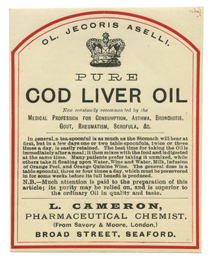
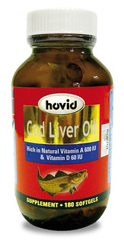
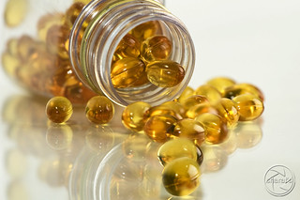
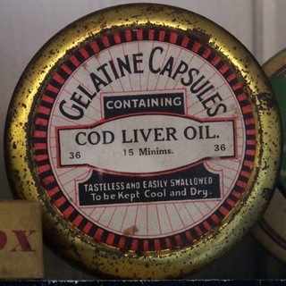
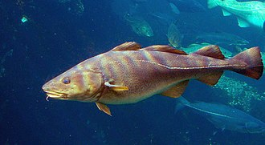
COD LIVER OIL
Cod liver oil can be obtained from eating fresh cod liver or by taking supplements.
Cod liver oil is used for high cholesterol, high triglycerides, kidney disease in people with diabetes, high blood pressure, heart disease, osteoarthritis, depression, an autoimmune disease called systemic lupus erythematosus (SLE), glaucoma, and middle ear infections (otitis media).
Some people put cod liver oil on their skin to speed wound healing.
Atlantic Cod from Genus Gadus

Slide 11
Conti…
Though similar in fatty acid composition to other fish oils, cod liver oil has higher concentrations of vitamins A and D.
According to the United States Department of Agriculture, a tablespoon (13.6 grams or 14.8 mL) of cod liver oil contains 4,080 μg of retinol (vitamin A) and 34 μg (1360 IU) of vitamin D.
The Dietary Reference Intake of vitamin A is 900 μg per day for adult men and 700 μg per day for women, while that for vitamin D is 15 μg per day.

Slide 12
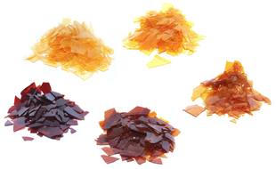
SHELLAC
Shellac is made by the insect Laccifer lacca. Don’t confuse shellac made by this insect with the varnish-like product found at hardware stores.
Varnish-like shellac contains methanol (wood alcohol) and is very poisonous.
In dentistry, shellac from Laccifer lacca is used to make dentures and other dental products.
In the pharmaceutical industry, shellac is used as a tablet coating and for other uses.
In manufacturing, shellac is used as a finish for furniture, an ingredient in hair spray and in other cosmetics.
Although shellac has been used for years in pharmacy, dentistry, and manufacturing, it has fallen into disfavor for some products because it ages over time.
Shellac does not have any medicinal uses.
Some of the many different colors
of shellac
Shellac (/ʃəˈlæk/)^{[1]} is a resin secreted by the female lac bug on trees in the forests of India and Thailand. It is processed and sold as dry flakes and dissolved in alcohol to make liquid shellac, which is used as a brush-on colorant, food glaze and wood finish. Shellac functions as a tough natural primer, sanding sealant, tannin-blocker, odour-blocker, stain, and high-gloss varnish. Shellac was once used in electrical applications as it possesses good insulation qualities and it seals out moisture. Phonograph and 78 rpm gramophone records were made of it until they were replaced by vinyl long-playing records from the 1950s onwards.
From the time it replaced oil and wax finishes in the 19th century, shellac was one of the dominant wood finishes in the western world until it was largely replaced by nitrocellulose lacquer in the 1920s and 1930s.

Slide 13
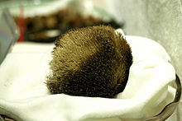
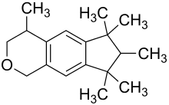
MUSK
Scientific Name(s): Moschus moschiferus L.
Common Name(s): Deer musk, Musk, Tonquin musk
Musk is a class of aromatic substances commonly used as base notes in perfumery.
They include glandular secretions from animals such as the musk deer, numerous plants emitting similar fragrances, and artificial substances with similar odors.
Musk was a name originally given to a substance with a strong odor obtained from a gland of the musk deer.
Wild animals, Plants…….
A musk pod, obtained from the male
musk deer
Galaxolide, a polycyclic musk commonly found in laundry detergents to mask the smell of the detergent chemicals

Slide 14
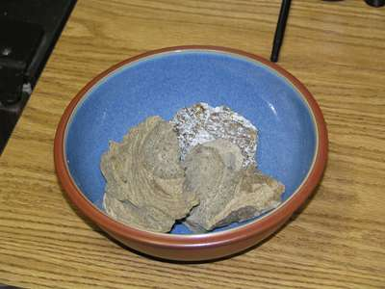
Ambergris
Ambergris (ambra grisea, Old French: ambre gris), ambergrease, or grey amber, is a solid, waxy, flammable substance of a dull grey or blackish color produced in the digestive system (intestine) of sperm whales (Physeter catodon).
Freshly produced ambergris has a marine, fecal odor.
In the West it was used to stabilize the scent of fine perfumes. Ambergris floats and washes ashore most frequently on the coasts of China, Japan, Africa, and the Americas and on tropical islands such as the Bahamas. Because it was picked up as drift along the shores of the North Sea, ambergris was likened to the amber of the same region, and its name is derived from the French words for “gray amber.”
Fresh ambergris is black and soft and has a disagreeable odour. When exposed to sun, air, and seawater, however, it hardens and fades to a light gray or yellow, developing a subtle and pleasant fragrance in the process. Pieces are usually small, but one chunk found in the Dutch East Indies weighed about 635 kg (1,400 pounds).

Slide 15
Conti…
It is a solid waxy disagreeable odorous substance obtained from sperm whale.
Ambergris is used to make perfume.
Chemically it contains ambrein, ambroxan, ambrinol, and ambroxide.
It is traditional used in treating general weakness, epilepsy, typhoid, fever, hysteria and other nervous disorders or afflictions.

Slide 16
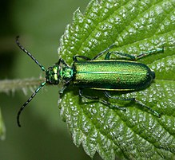
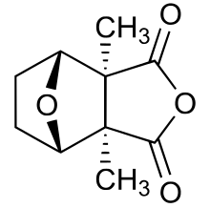
CANTHARIDIN
Spanish fly
Cantharidin is an odorless, colorless fatty substance of the terpenoid class, which is secreted by many species of blister beetles.
It is a burn agent or a poison in large doses, but preparations containing it were historically used as aphrodisiacs.
USES
Diluted solutions of cantharidin can be used as a topical medication to remove warts and tattoos and to treat the small papules of molluscum contagiosum.
In Santería rituals, cantharides are used in anger.
CANTHARIDIN
The Spanish fly (Lytta vesicatoria) is an emerald-green beetle in the blister beetle family (Meloidae). It and other such species were used in preparations offered by traditional apothecaries, often referred to as Cantharides or Spanish fly. The insect is the source of the terpenoid cantharidin, a toxic blistering agent once used as an aphrodisiac.
L. vesicatoria is sometimes called Cantharis vesicatoria,^{[1]} although the genus Cantharis is in an unrelated family, Cantharidae, the soldier beetles.
Cantharidin is dangerously toxic, inhibiting the enzyme phosphatase 2A. It causes irritation, blistering, bleeding and discomfort. These effects can escalate to erosion and bleeding of mucosa in each system, sometimes followed by severe gastro-intestinal bleeding and acute tubular necrosis and glomerular destruction, resulting in gastro-intestinal and renal dysfunction, by organ failure, and death.

